Slide 1
Bio211 Biostatistics and Experimental Design Winter Term 2018
Lecture 1 Introduction
January 8, 2018

Slide 2
Outline for today
Personal introductions
Content introduction
Why do we need statistics in science?
Course administrative details
Syllabus, course website, etc.

Slide 3
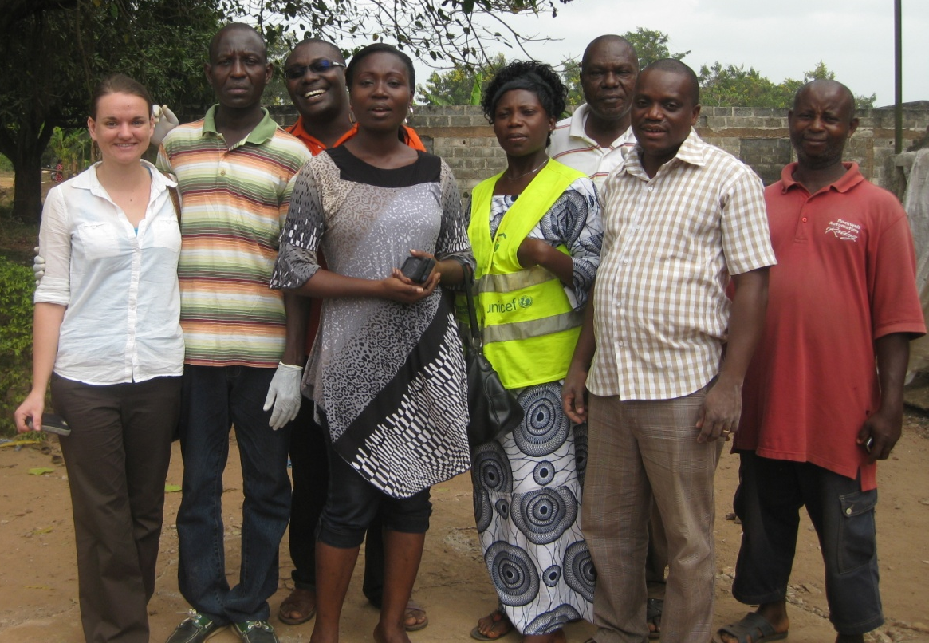
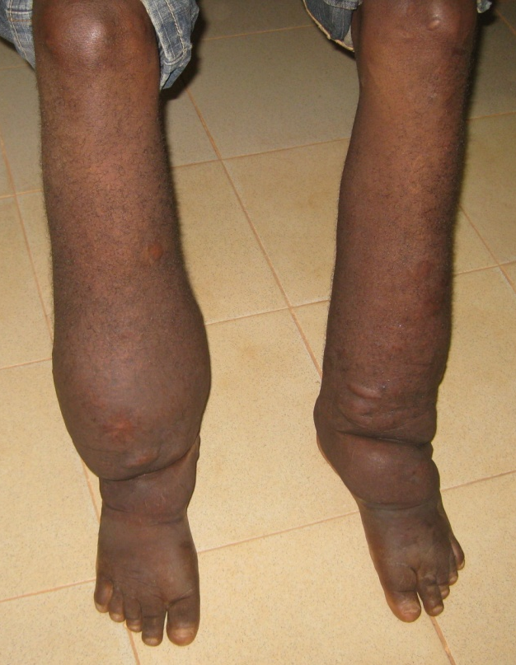
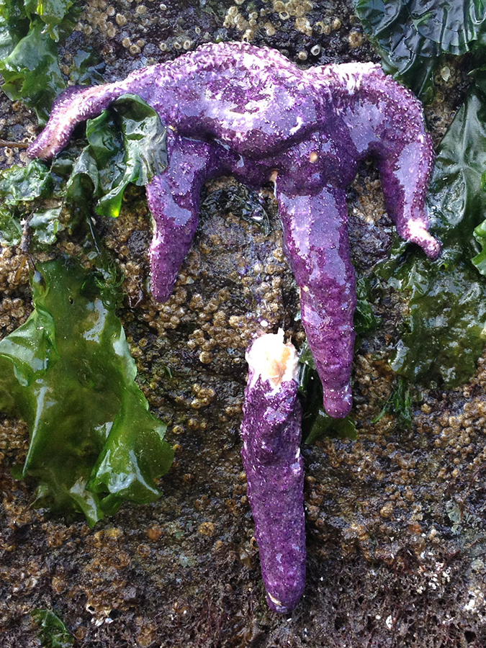
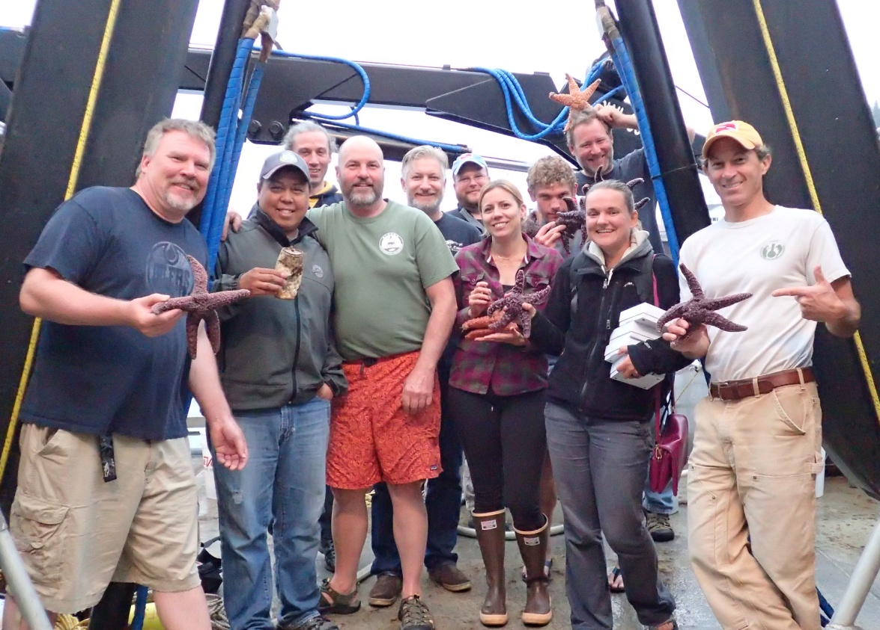

Slide 4
Why do we need statistics in science?
Statistics is the collection, organization, analysis, and interpretation of data
Quantitatively draw conclusions from patterns in data

Slide 5
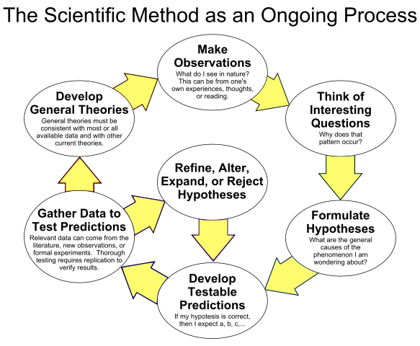
Why do we need statistics in science?

Slide 6
Why do we need statistics in science?

Slide 7
Why do we need statistics in science?
Descriptive: summarize or describe data
Inferential: techniques that allow us to use samples from a larger population to make generalizations about that populations.

Slide 8
Class wiki page
The vast majority of course content can be found on the wiki page:
https://github.com/mlloyd23/bio211_JAN2018/wiki

Slide 9
Syllabus and Questionnaire
Turn in the questionnaire to me by the end of the day today!

Slide 10
Grading
Assignments: 50% (10 assignments; 5% each)
Mid term quiz: 10%
Final Paper: 15%
Final Exam: 25%

Slide 11
Human Subjects Training
This afternoon we are going to use human subjects (ourselves) in our lab. Please complete the human subjects training by next class (Wednesday 1/10/18)
https://phrp.nihtraining.com/users/login.php

Slide 12
Assignment 1
Read an article in a biology journal of your choice
Pay close attention to the Method and Results sections
Write a summary of the article
Answer the following questions:
What is the hypothesis the authors are testing?
What is the null hypothesis?
Did their results support the hypothesis? Explain
What statistical test did they perform?
Cite the article

Slide 13
Summary
Questionnaire returned to me by end of today
Human Subjects Training by Wednesday morning
Assignment 1 by Wednesday morning

